Slide 1
Wine Price & Rating Prediction
Thinkful Supervised Learning Capstone

Slide 2
Dataset Overview
This dataset was scraped from Wine Enthusiast by Zach Thoutt, and posted on Kaggle.
Goal: to create models that will try to predict the price of of a bottle of wine or the points rating of a wine, based on wine review data.
Target Variables
Wine price (price of a 750 ml bottle)
Wine rating

Slide 3
Process Outline
Initial exploratory data analysis
Variable exploration
Feature Engineering
Dimensionality Reduction
Regression Modeling for Price and Points

Slide 4
Dataset Information
country: The country that the wine is from
description: A few sentences from a sommelier describing the wine's taste, smell, look, feel, etc.
description: A few sentences from a sommelier describing the wine's taste, smell, look, feel, etc
designation: The vineyard within the winery where the grapes that made the wine are from
points: The number of points WineEnthusiast rated the wine on a scale of 1-100 (though they say they only post reviews for wines that score >=80)
price: The cost for a bottle of the wine
province: The province or state that the wine is from
region_1: The wine growing area in a province or state (ie Napa)
region_2: Sometimes there are more specific regions specified within a wine growing area (ie Rutherford inside the Napa Valley), but this value can sometimes be blank
Was excluded as most of the values were missing
variety: The type of grapes used to make the wine (ie Pinot Noir)
winery: The winery that made the wine

Slide 5
Data Cleaning
Region_2 removed – due to mostly missing values
Duplicate entries were removed, searched by description
Null values removed

Slide 6
Dataset Information (post cleaning)
83,495 rows of data
41 different countries represented
352 provinces
947 regions
442 varieties of wine

Slide 7
Limitations of dataset
No variable for alcohol by volume. % ABV is also included on wine labels, so that information would be available to the intended users of these models.
Points ratings in this set are all between 80 and 100 points.
Wine reviews are all subjective, written by sommeliers (trained and knowledgeable wine professionals)

Slide 8


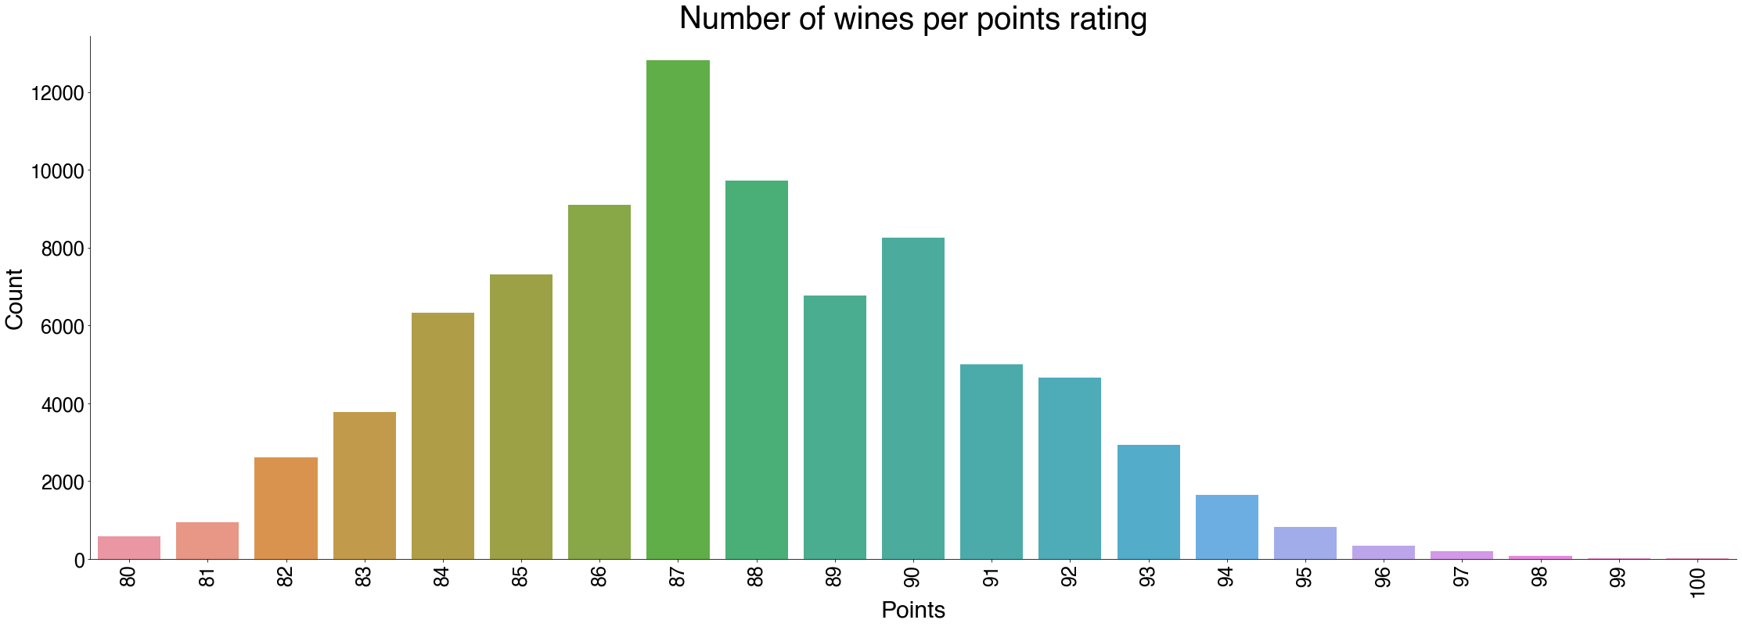
Exploring target variables: Points
Mean points rating: 87.63
Median rating: 87
Range: 80- 100

Slide 9
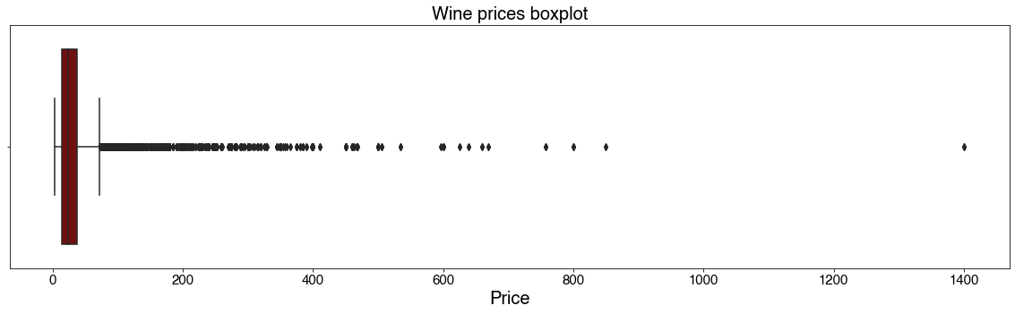
Exploring target variables: Price
Mean price = $32.06
Median price = $24
Cheapest wine: $4
Most expensive wine: $1400
This is an outlier, will be removed
Dataset relegated to wines under $1000

Slide 10
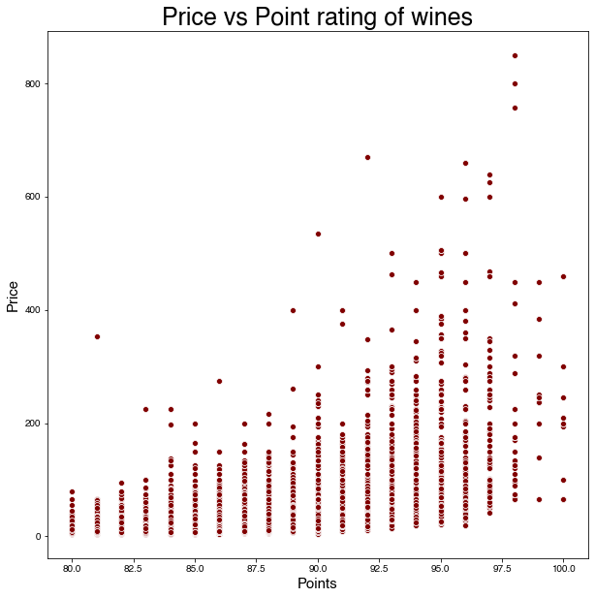
Target variable relationship
Wine prices and points don’t seem to exhibit a strong correlation, although there is a slight trend for higher rated wines to be more expensive

Slide 11
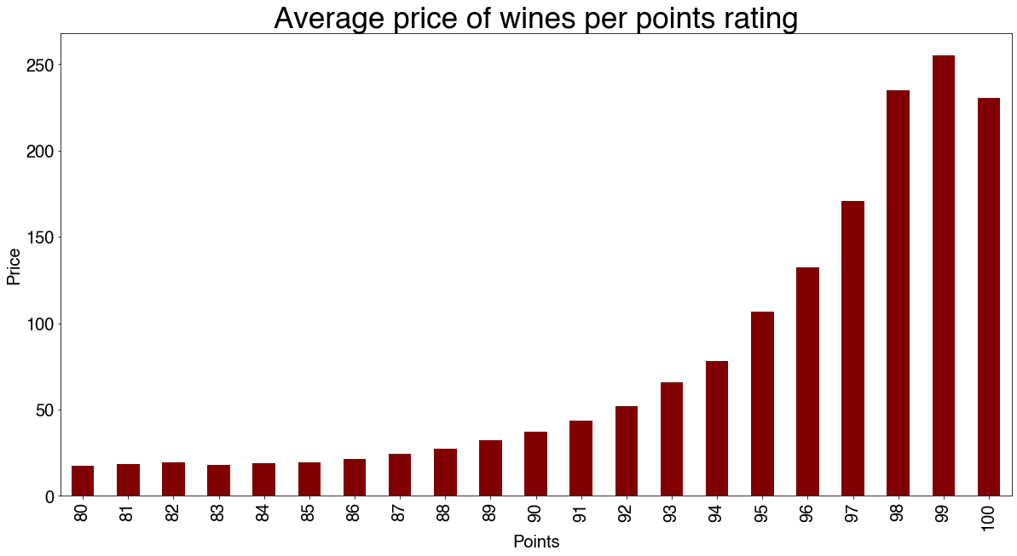
Target variable relationship
Average prices for wines are relatively similar for wines below a rating of 90
Above 90 point wines, there is an increasingly large difference for each additional point rating

Slide 12
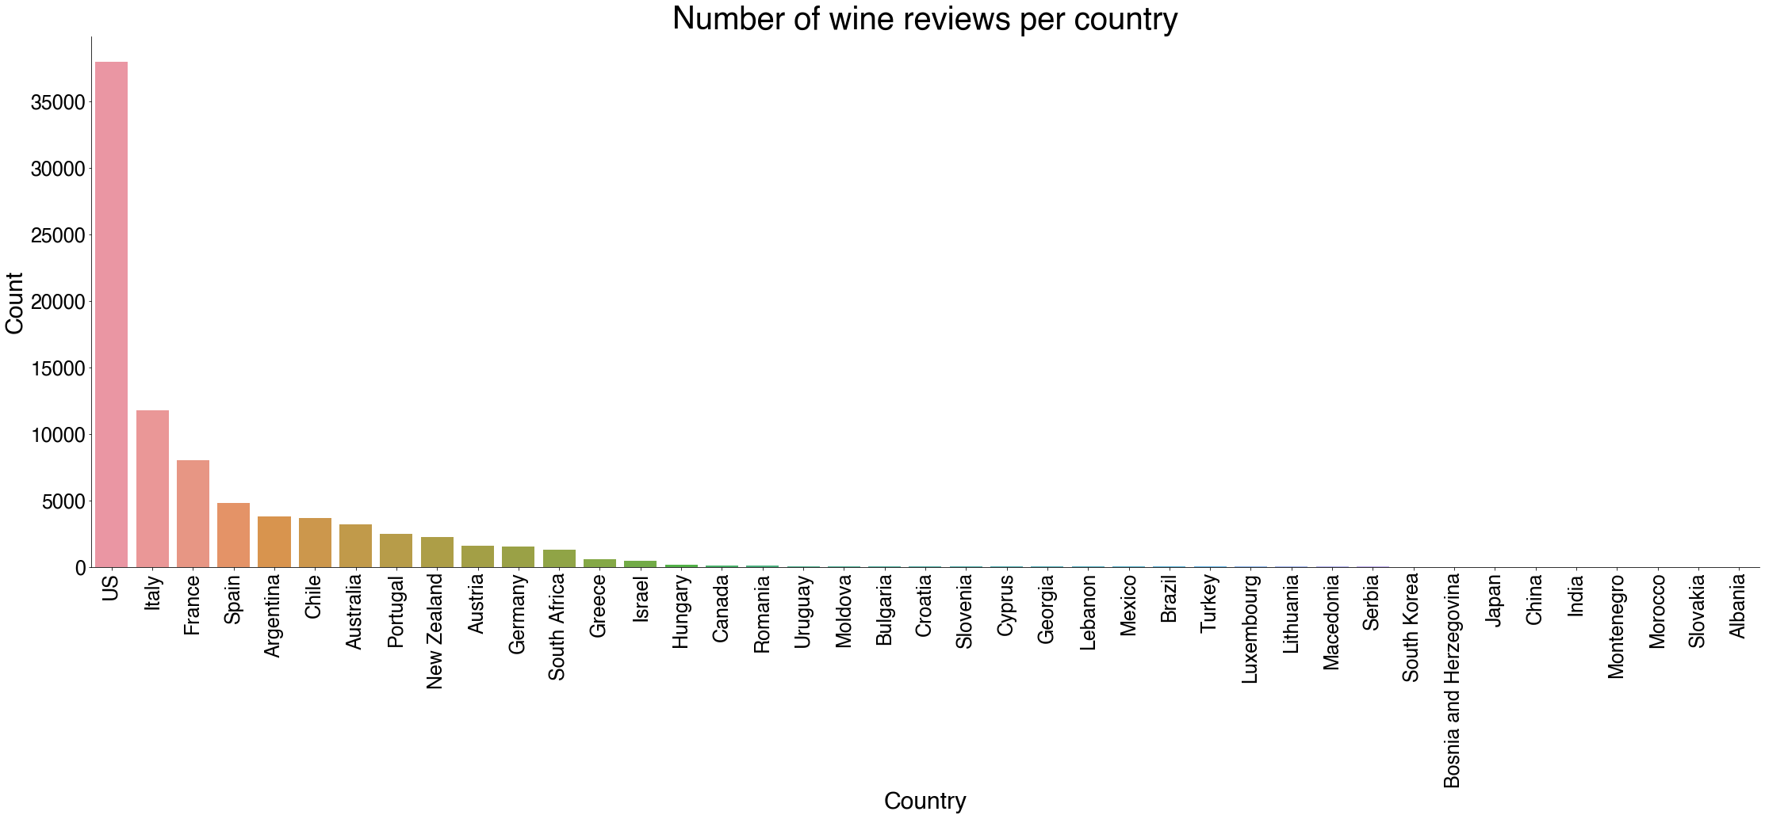
Variable exploration: Country
41 countries represented
Dataset is predominantly US wines
45% of dataset
Italy, France, Spain, Argentina, Chile are next most popular wines in dataset

Slide 13
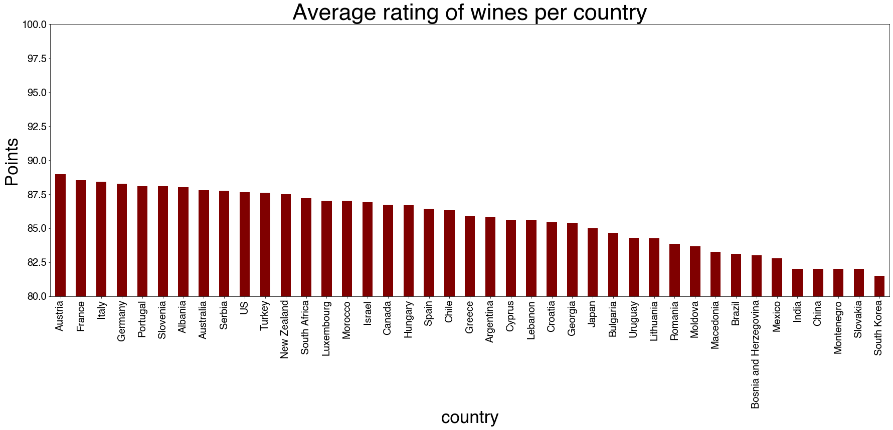
Who makes the best wine?
Austria 88.973667
France 88.536421
Italy 88.392954
Germany 88.247333
Portugal 88.081493
Slovenia 88.064516
Albania 88.000000
Australia 87.796648
Serbia 87.750000
US 87.641022

Slide 14
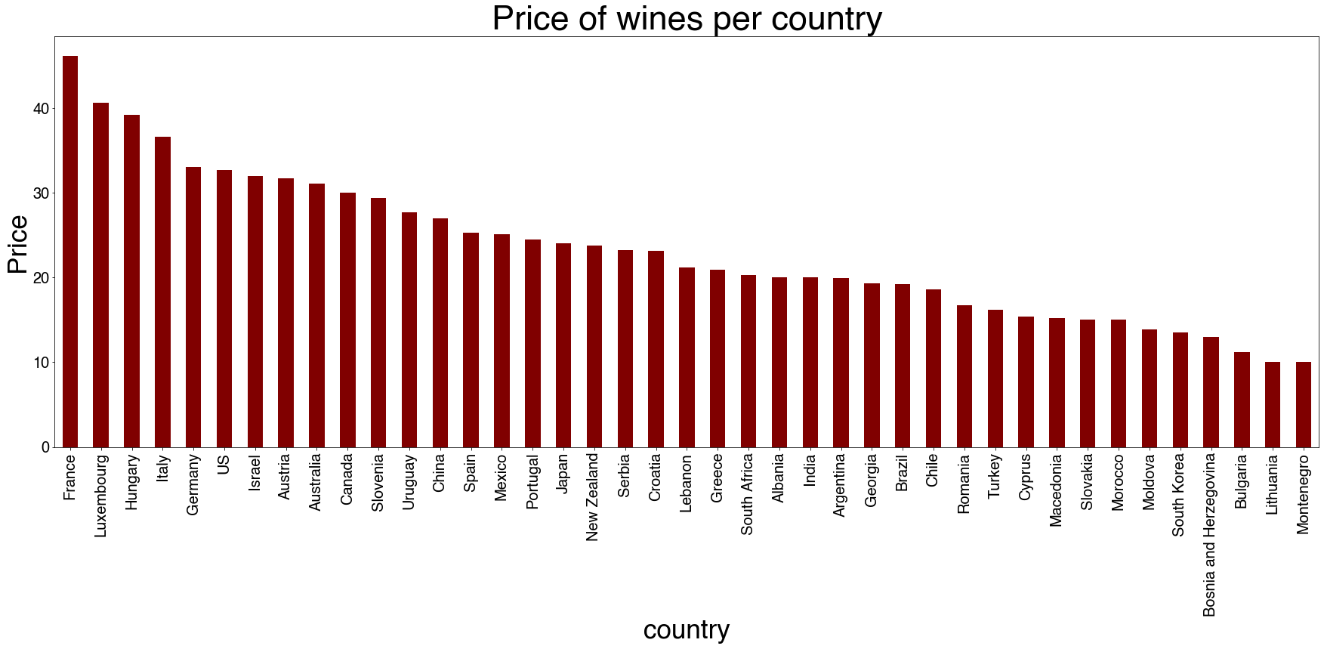
Who makes the most expensive wine?
France 46.168461
Luxembourg 40.666667
Hungary 39.173410
Italy 36.616576
Germany 33.028667
US 32.686207
Israel 31.973913
Austria 31.694284
Australia 31.055345
Canada 29.975904

Slide 15
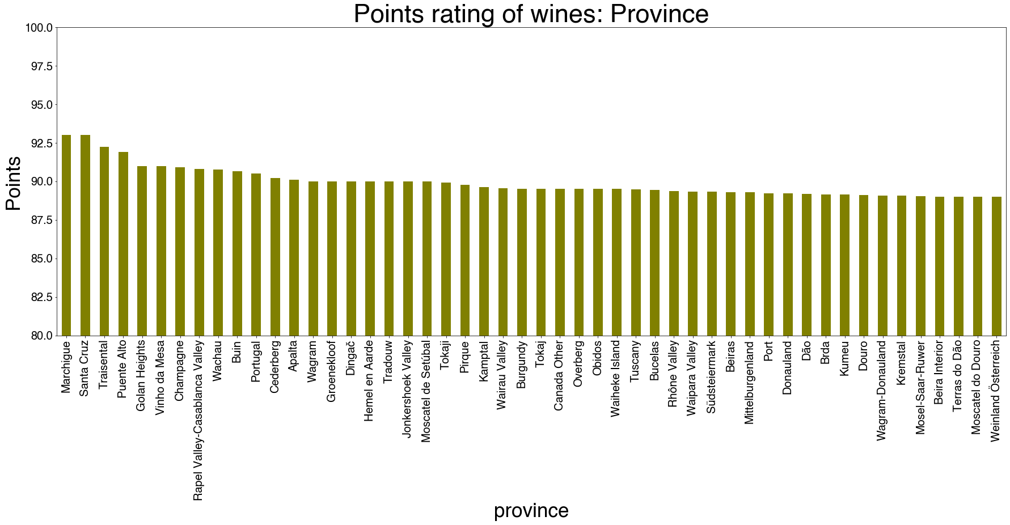
Variable exploration: Province (rating)
Average rating of wine by province:
Marchigue 93.000000 (Chile)
Santa Cruz 93.000000 (Chile)
Traisental 92.250000 (Austria)
Puente Alto 91.923077 (Chile)
Golan Heights 91.000000 (Israel)
3 of the top 5 highest rated provinces are in Chile, even though Chile is not in the top 10 highest rated countries

Slide 16
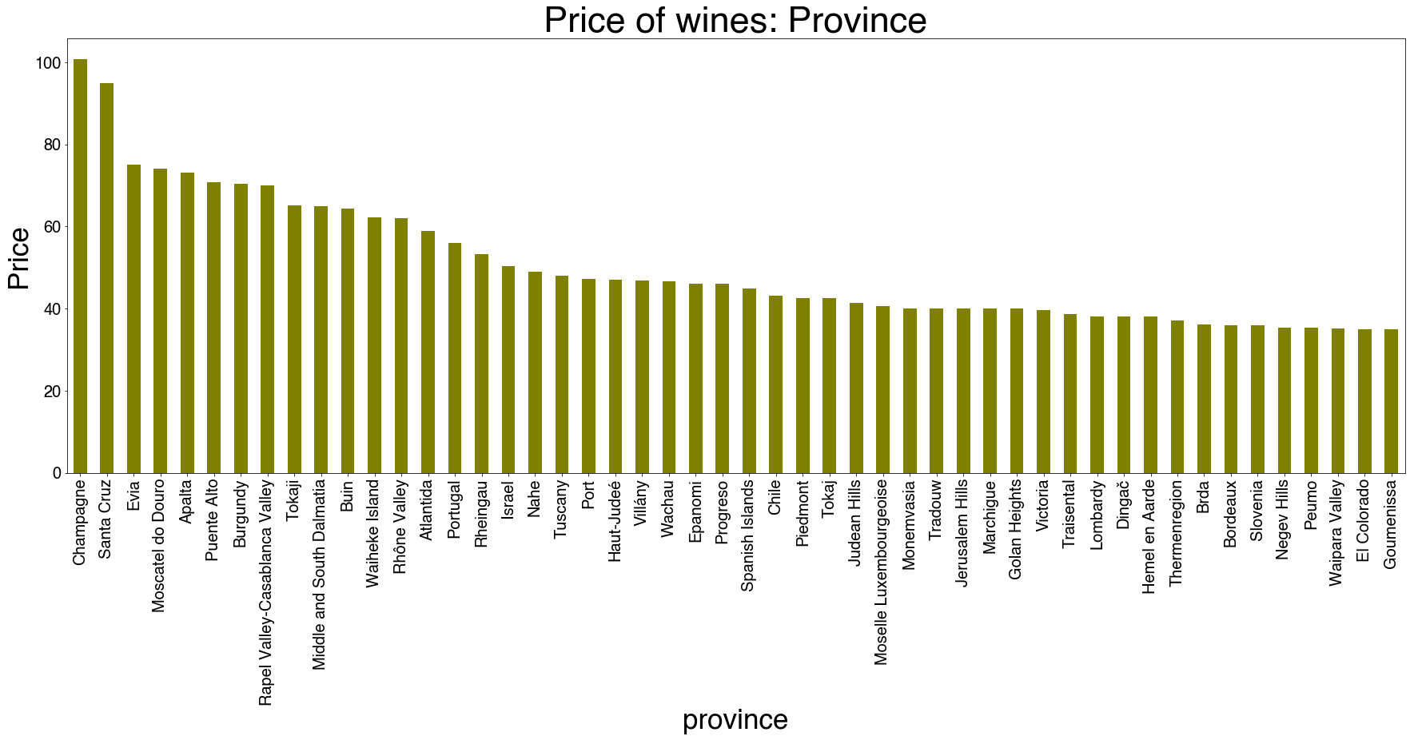
Variable exploration: Province (price)
Champagne 100.764310 (France)
Santa Cruz 95.000000 (Chile)
Evia 75.000000 (Greece)
Moscatel do Douro 74.000000 (Portugal)
Apalta 73.111111 (Chile)
While the most expensive wines are from Champagne, in France (also the most expensive country for wine, on average), wines from Santa Cruz province and Apalta province in Chile are the second and fifth most expensive. Chilean wines from select provinces seem to be very premium wines!

Slide 17
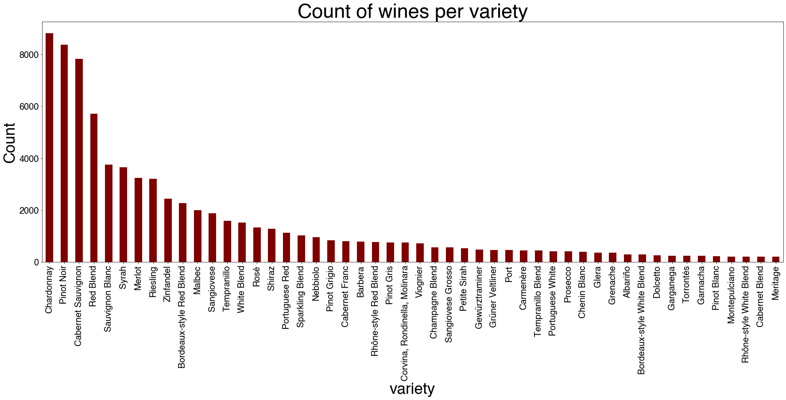
Variable exploration: Variety
Varieties of wine by percentage (top 10):
Chardonnay 10.51
Pinot Noir 9.97
Cabernet Sauvignon 9.33
Red Blend 6.81
Sauvignon Blanc 4.48
Syrah 4.34
Merlot 3.86
Riesling 3.83
Zinfandel 2.91
Bordeaux-style Red Blend 2.70

Slide 18
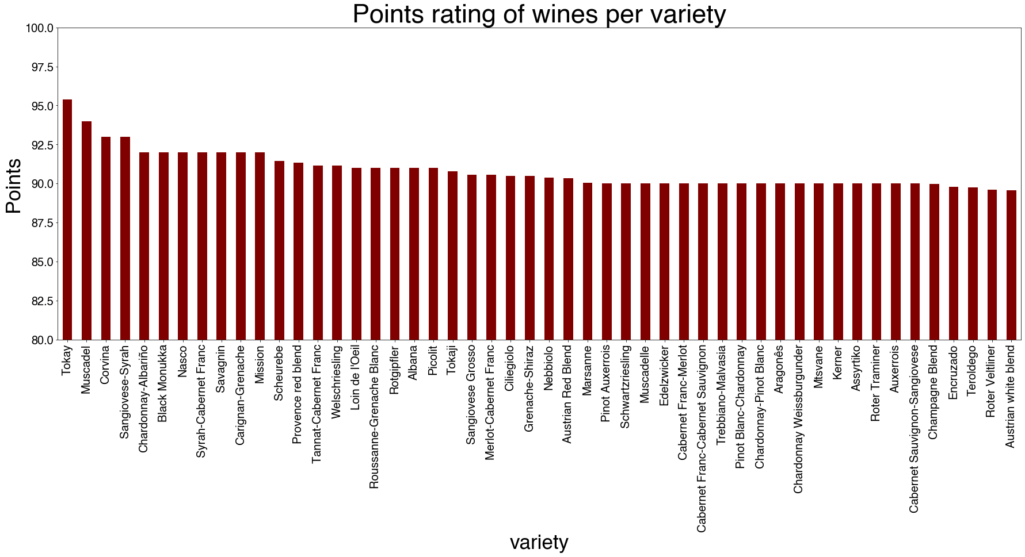
Variable exploration: Variety (points)
Tokay 95.375
Muscadel 94.000
Corvina 93.000
Sangiovese-Syrah 93.000
Chardonnay-Albariño 92.000
Black Monukka 92.000
Nasco 92.000 S
yrah-Cabernet Franc 92.000
Savagnin 92.000
Carignan-Grenache 92.000

Slide 19
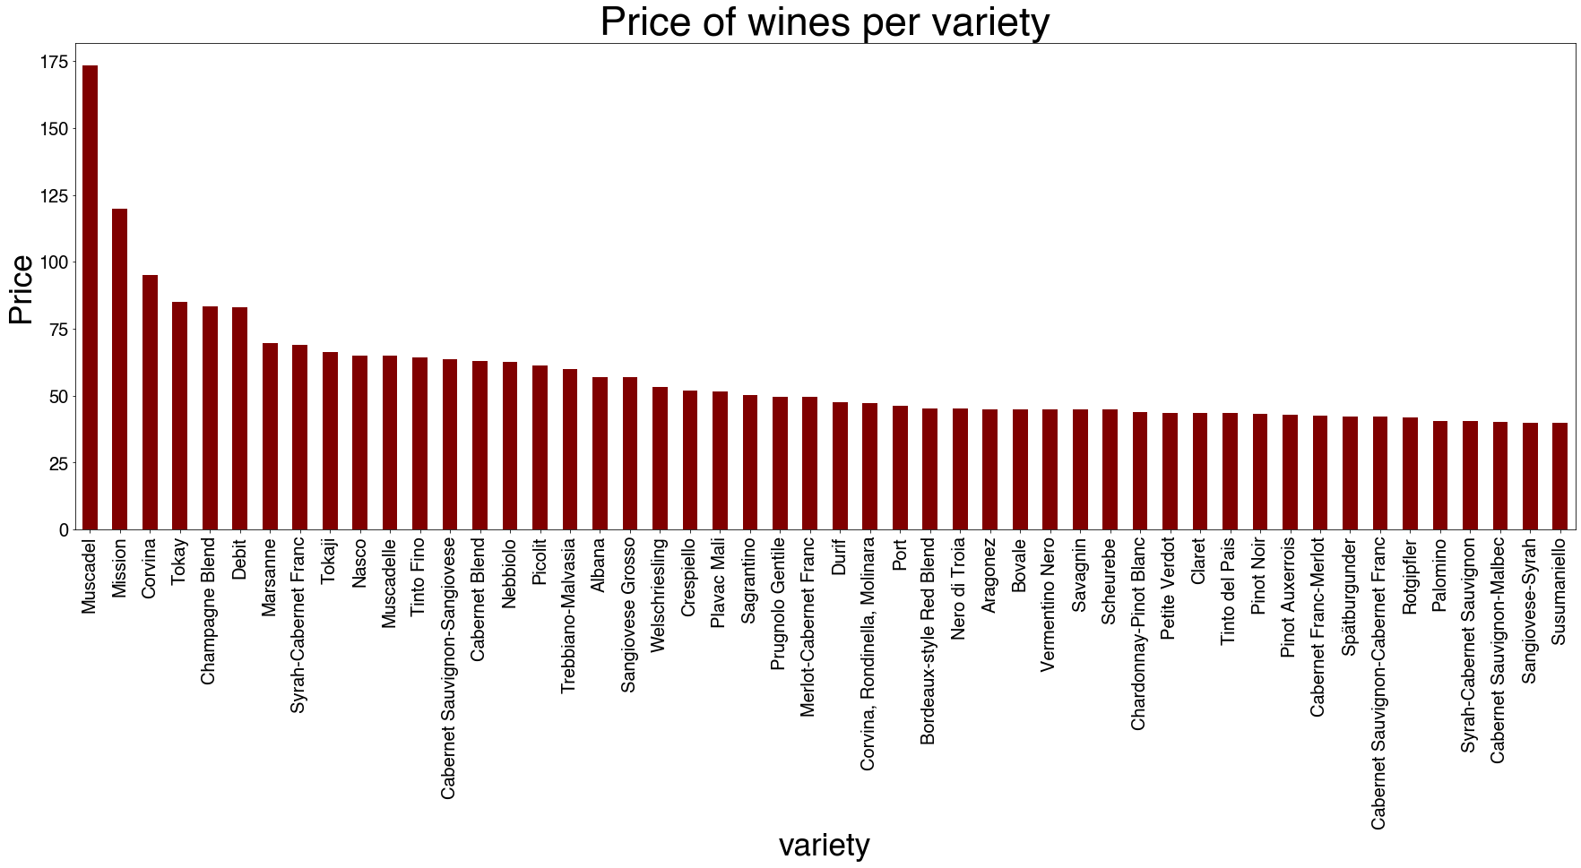
Variable exploration: Variety (price)
Muscadel 173.250000
Mission 120.000000
Corvina 95.000000
Tokay 85.125000
Champagne Blend 83.273519
Debit 83.200000
Marsanne 69.636364
Syrah-Cabernet Franc 69.000000 T
okaji 66.420000
Nasco 65.000000
While Chardonnay is the most common variety of wine, it is neither the most expensive nor the highest rated wine. Muscadel is the most expensive variety of wine in our dataset, and Tokay is the highest rated.

Slide 20
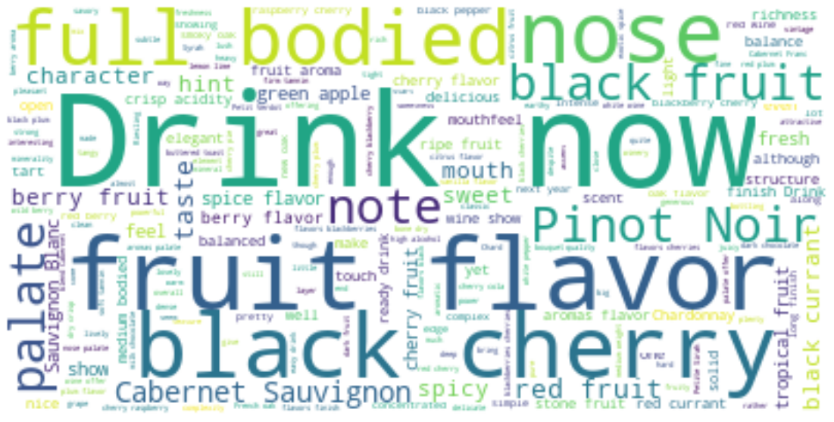
Variable exploration: Description
The description of the wines is what a sommelier says about a particular wine
Descriptions could hold insights into wine ratings, as well as ratings

Slide 21
Feature Engineering

Slide 22
Feature Engineering: Origin
Country, province, region_1, and winery are hierarchical features
Not mutually exclusive, including them all doesn’t make sense.
In order to reduce dimensionality, we will combine country and province into a feature called ”origin”
The variance in the points and prices of wines by region and winery will be captured by the origin feature
The origin feature will be composed of the country and province, specifically provinces with at least 100 wines.

Slide 23
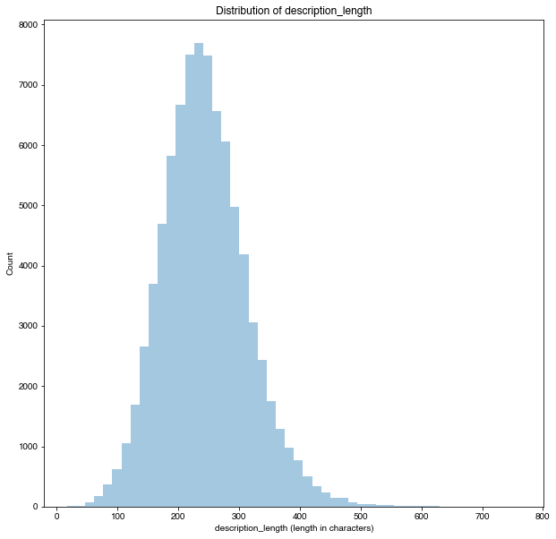
Feature Engineering: Description length
Creating a feature to get the length of each description, as it may help in predicting the points/price of the wine
Interesting to see a fairly normal distribution for the description lengths

Slide 24
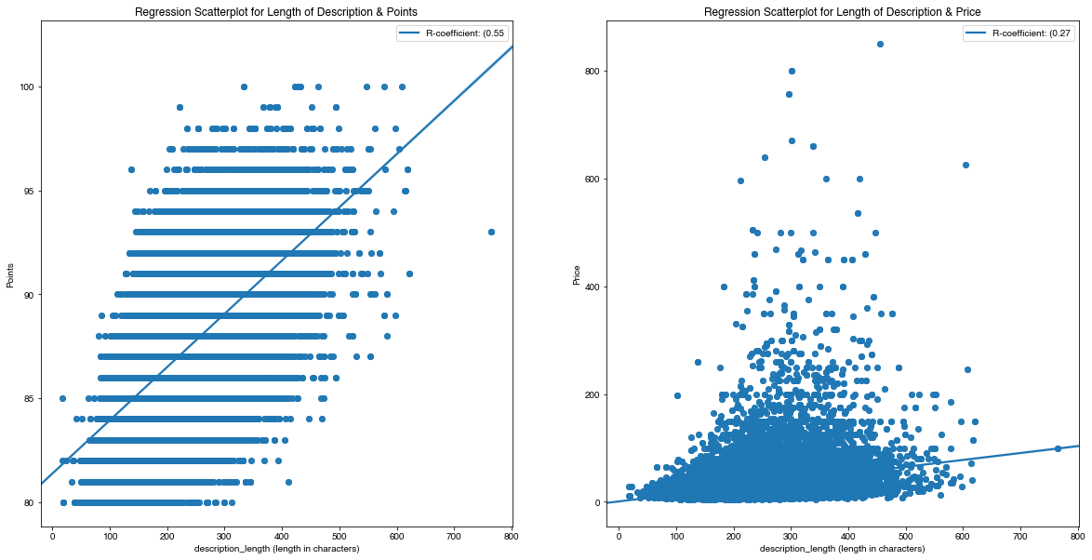
Feature Engineering: Description length
Visualizing description_length and its relationship to price and points

Slide 25
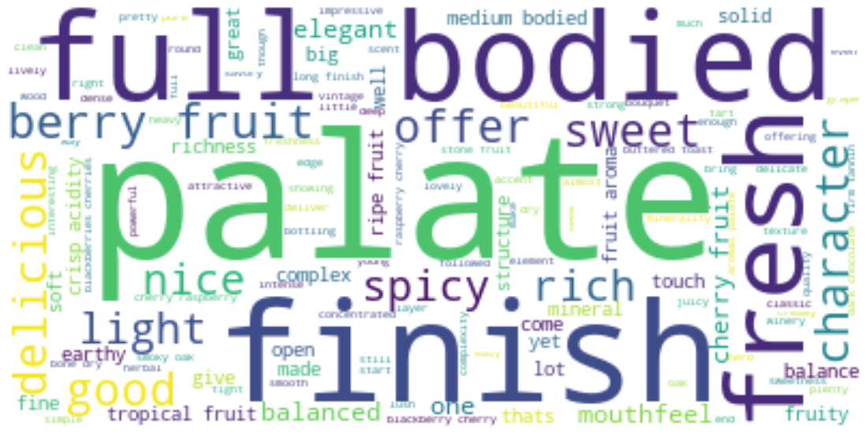
Feature Engineering: Wine descriptions
Cleaned up the text
Lower case
Remove punctuation
Change characters to ordinary ASCII format
Removed wine varieties and provinces from descriptions
361 unique words that appear in 'variety' that will be taken out of the description
397 unique words that appear in 'province' that will be taken out of the description
Removed ”stopwords”
Words that do not contribute meaningfulness to a description
E. g. "drink", "theres", "like", "now", "wine", "flavor", "flavors", "taste", etc.
Leaves us with 20662 unique words across all the descriptions

Slide 26
Analyzing Wine Descriptions
TF-IDF (Term frequency-inverse document frequency)
What is Tf-idf?
In this case, Tf-idf is a technique for determining roughly what each description in a set of descriptions is “about”. It accomplishes this by looking at two simple metrics:
tf (term frequency) Term frequency is the proportion of occurrences of a specific word to total number of words in a description.
idf (inverse document frequency) Inverse document frequency is the inverse of the proportion of descriptions that contain that word/phrase.
The general idea is that if specific words appears a lot of times in a given description, but dont appear in many other descriptions, then we have a good idea that those words are important in distinguishing that description, and that wine from all the others.
Using TfidfVectorizer to vectorize our descriptions
Setting min_df = 50, which means a word must appear in at least 50 documents to be counted
This is a way to avoid counting proper nouns and other words that do not tell us much about the characteristics of a wine

Slide 27
Dimensionality Reduction

Slide 28
Dimensionality reduction (TF-IDF)
Vectorizing our descriptions yields a 83942 x 3051 sparse matrix describing the information contained in the wine's description.
Having 3051 features is computationally very taxing
Using SVD we can reduce the size of the TF-IDF description matrix
Used TruncatedSVD module from sklearn
What is SVD?
The Singular-Value Decomposition, or SVD for short, is a matrix decomposition method for reducing a matrix to its constituent parts in order to make certain subsequent matrix calculations simpler.

Slide 29
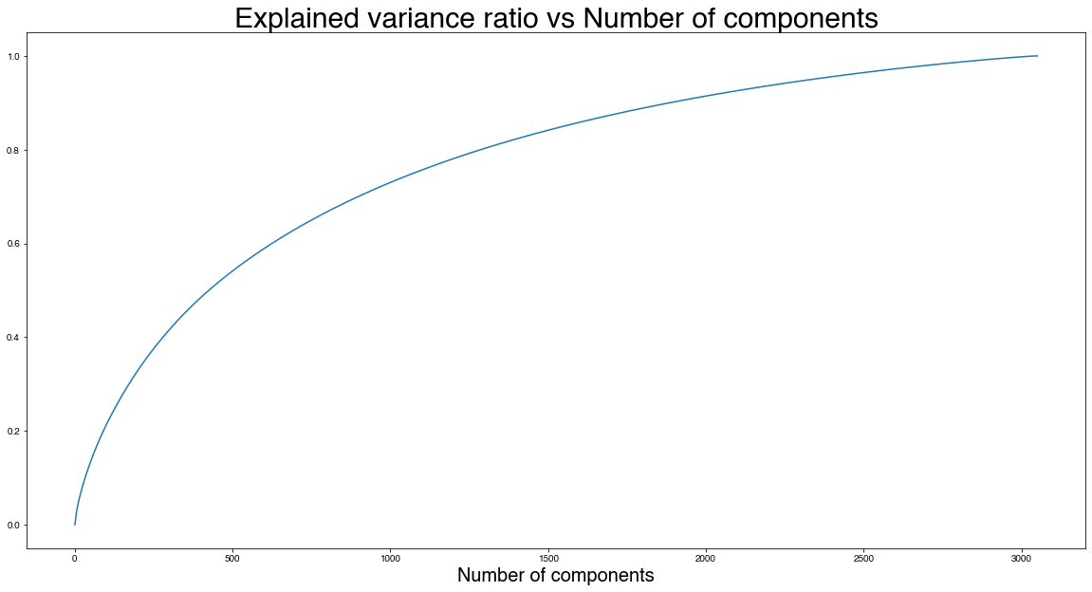
Dimensionality Reduction of Description TF-IDF matrix
The graph indicates that we can decompose our original 3051 column TF-IDF sparse matrix into 1500 components, while explaining 83.9% of the variance in the original matrix.
Reducing our Description TF-IDF feature size by 50% while only sacrificing 16.1% of the variance in the original feature is a fair tradeoff for better runtimes and manageability when it comes to modeling.

Slide 30
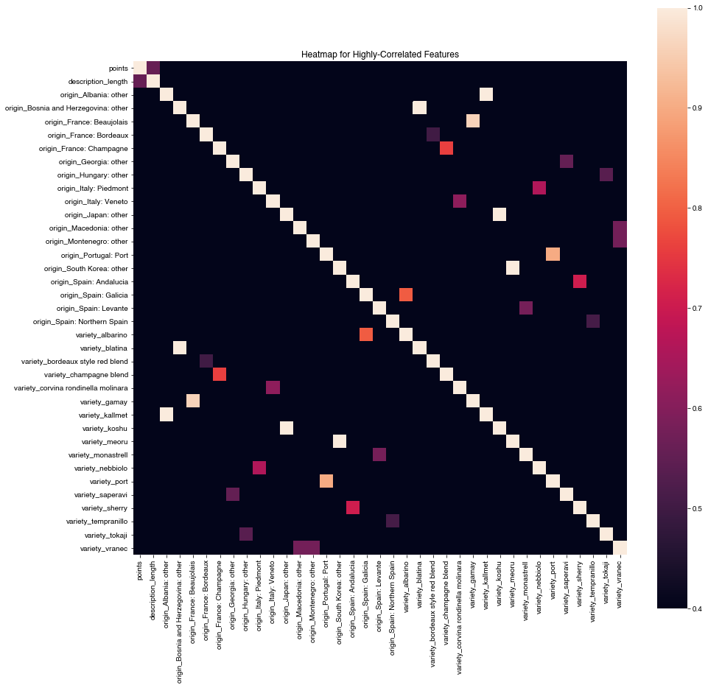
Feature Engineering: Origin and Variety
We have 442 different varieties and 112 different origins for the wines in our feature set
First, One-hot-encoding our categorical origin and variety variables into continuous variables for modeling
Addressing multicollinearity:
There is collinearity here between origins and varieties, due to wines commonly produced in specific regions. For instance, a wine can only be labeled "Bordeaux" if it's from the Bordeaux region of France

Slide 31
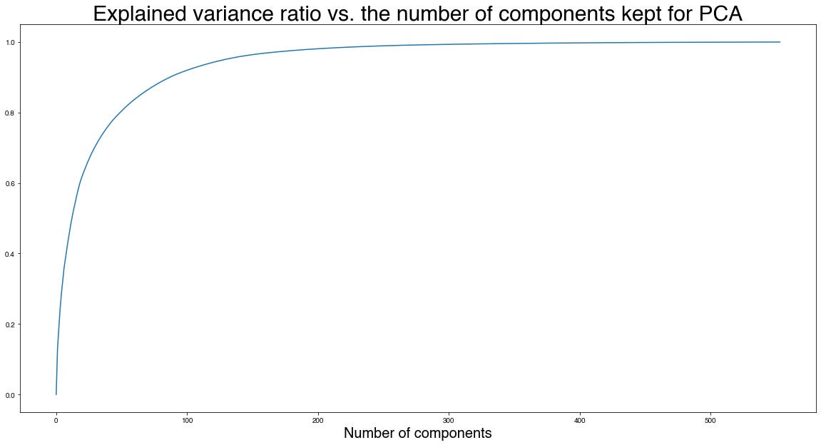
Dimensionality Reduction: Origin and Variety
We can reduce the one-hot encoded combination of origin and variety from 554 to 100 components using PCA, accounting for almost 92% of the variance in the origin and variety data, while removing multicollinearities.
PCA will address all multicollinearities within the wine origins and varieties

Slide 32
Regression Modeling for Wine Price and Points

Slide 33
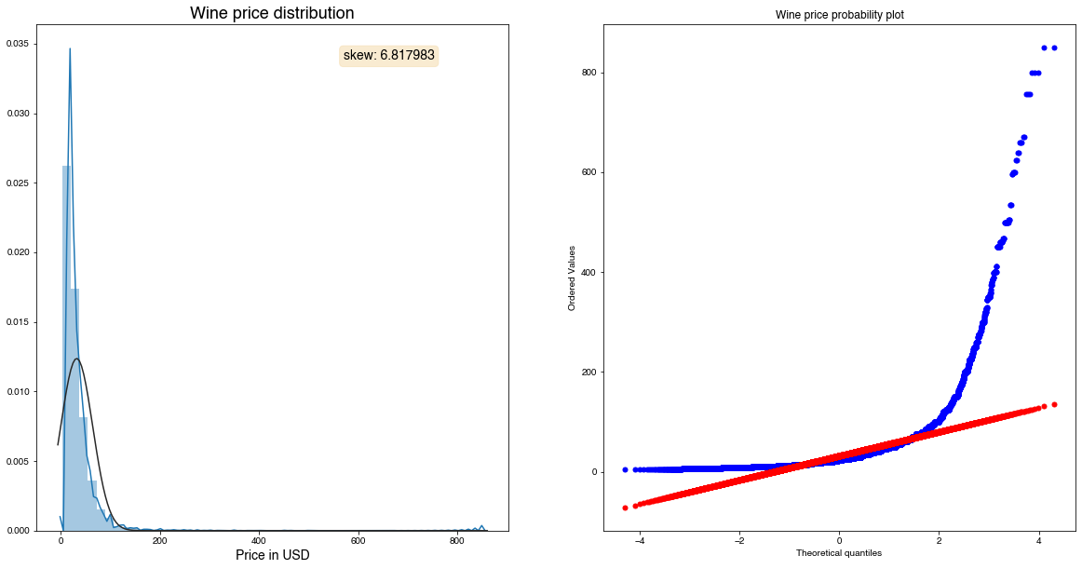
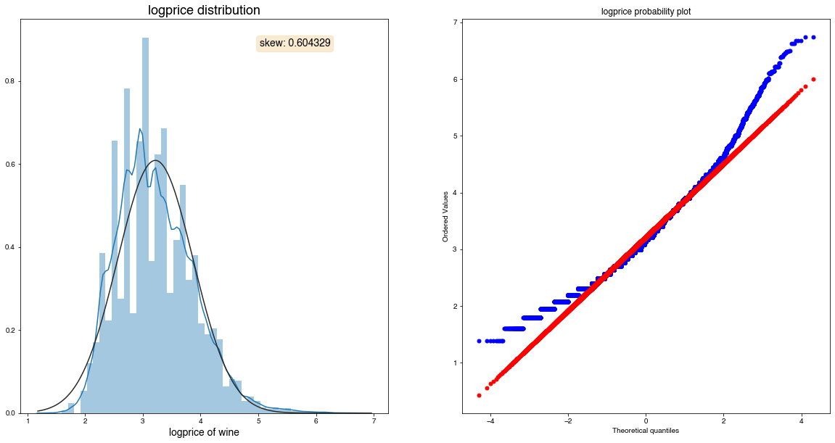
Target: Price
Price is heavily skewed and needs to be transformed prior to modeling, to make the relationship between variables more linear
We will log transform the data and create a new target variable, logprice
Log transforming wine price results in a much more normal distribution
Target will be logprice

Slide 34
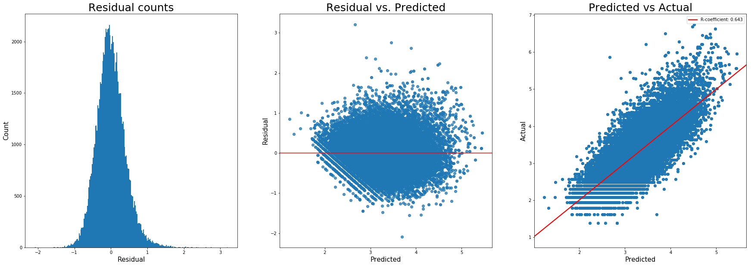
Ordinary Least Squares Regression: Price
Getting a baseline performance for our feature set
R-squared of the model in training set is: 0.6454304256596026
-----Test set statistics-----
R-squared of the model in test set is: 0.6337740098468788
Root mean squared error of the prediction is: 0.39591867625262495
OLS Regression Total runtime: 44.32 seconds

Slide 35
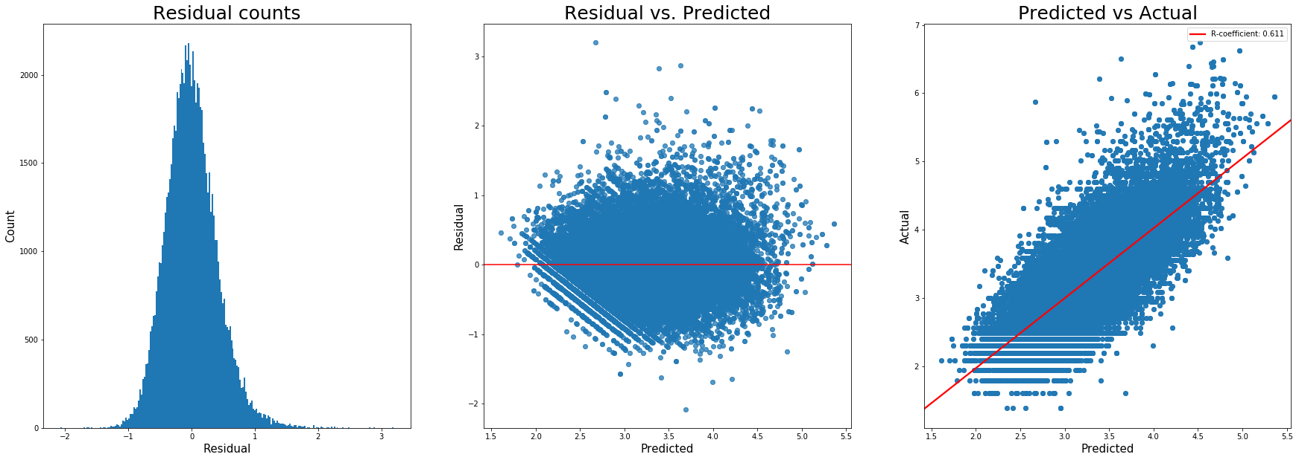
LASSO L1 Linear Regression: Price
Next, LASSO regression
Testing to see if the regularization coefficient would help in terms of further reducing our variables
Best alpha value is: 0.0001 (Tuned with LassoCV)
R-squared of the model in training set is: 0.6117231605358859
-----Test set statistics-----
R-squared of the model in test set is: 0.6107204778058165
Root mean squared error of the prediction is: 0.4081898365424524
LASSO Regression Total runtime: 81.63 seconds

Slide 36

Ridge L2 Linear Regression: Price
Trying to see if a different type of regularization (as opposed to LASSO) would provide better performance:
Best alpha value is: 1.0 (Tuned with RidgeCV)
R-squared of the model in training set is: 0.645323996443379
-----Test set statistics-----
R-squared of the model in test set is: 0.6343438854333265
Root mean squared error of the prediction is: 0.3956105164900309
Ridge Regression Total runtime: 354.19 seconds

Slide 37
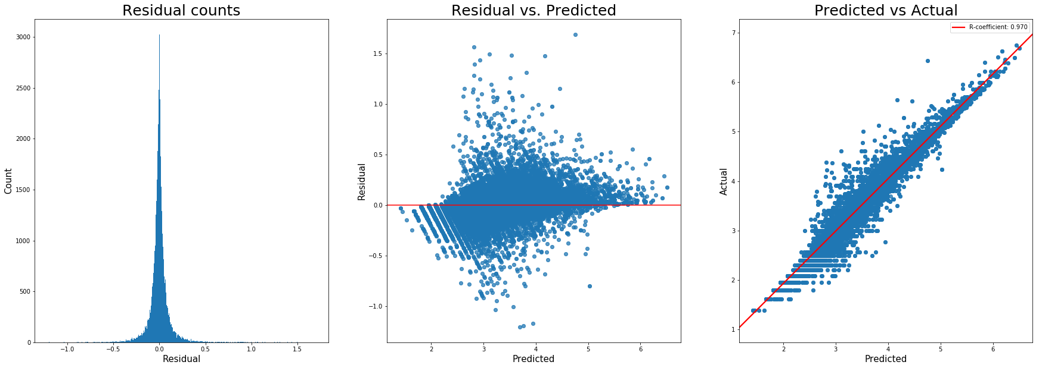
Random Forest Regression: Price
R-squared of the model in training set is: 0.987134805425895
-----Test set statistics-----
R-squared of the model in test set is: 0.9053025379768032
Root mean squared error of the prediction is: 0.2013263303940347
Random Forest Regression Total runtime: 11256.34 seconds
Hyperparameters tried: n_estimators = 10, 100
These are results from n_estimators = 100

Slide 38
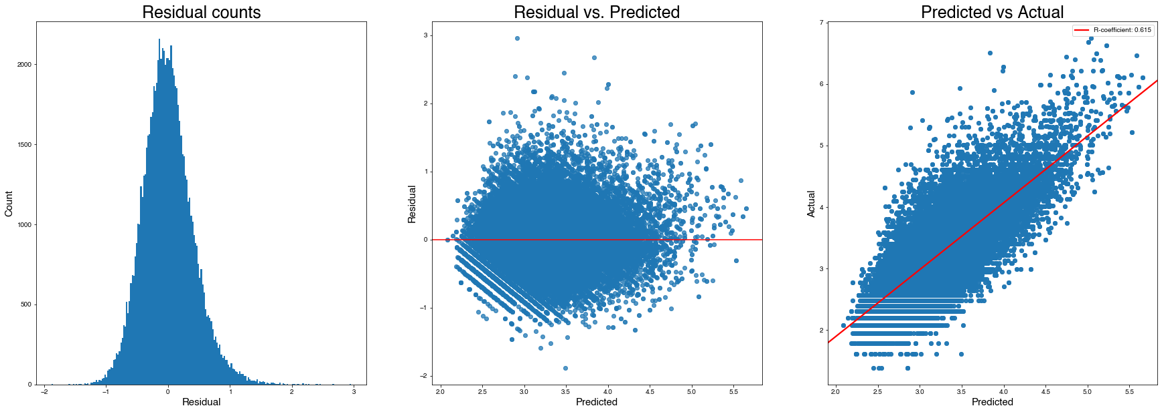
XGBoost Regression: Price
R-squared of the model in training set is: 0.6171998873278086
-----Test set statistics-----
R-squared of the model in test set is: 0.6090637205385998
Root mean squared error of the prediction is: 0.40905753368673875
XGBoost Regression Total runtime: 665.15 seconds

Slide 39
Price (logprice) Regression results
Random Forest Regression outperformed all the other models, with good performance.Highest R-squared (0.90)
Lowest Error RMSE (0.20)
This translates to an RMSE of +/- $1.22 per bottle of wine
Caveat: Extremely long runtime (11256.34 seconds), thats 3 HOURS

Slide 40
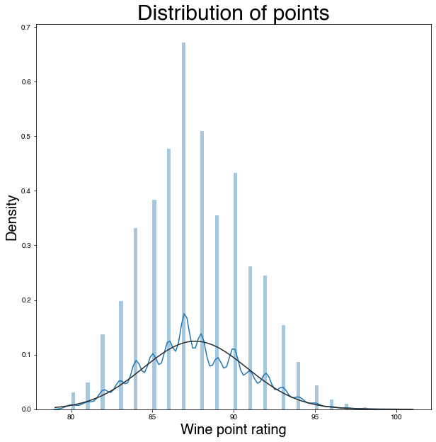
Points Regression
Now we will try to predict the points rating of a wine, based only on review descriptions and origin information.
We will not be using price, because the quality of a wine should be in its characteristics, not its price. The description length will be included as a feature to predict the points rating, however.
Point rating predictions were rounded to whole numbers, as all wine ratings are integer values
Because points looks fairly normal in it's distribution, no transformation will be applied

Slide 41
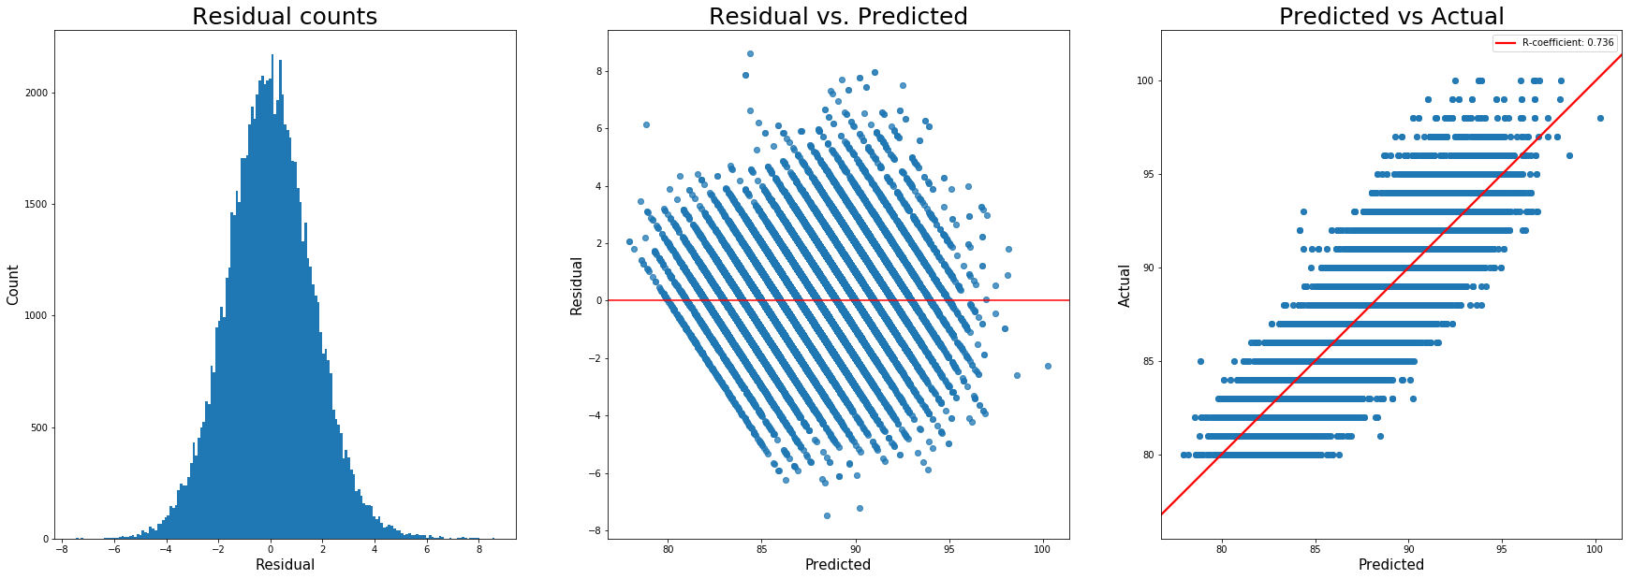
OLS: Points
R-squared of the model in training set is: 0.7390007500488321
-----Test set statistics-----
R-squared of the model in test set is: 0.7260402707032357
Root mean squared error of the prediction is: 1.6989799436394633
OLS Regression Total runtime: 39.28 seconds

Slide 42
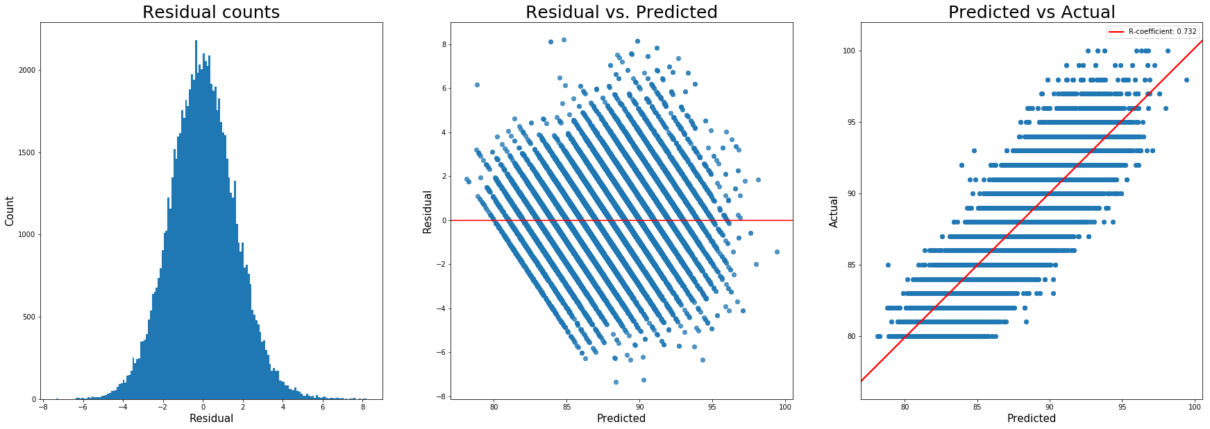
LASSO L1 Regression: Points
Best alpha value is: 0.0001
R-squared of the model in training set is: 0.7351781233348127
-----Test set statistics-----
R-squared of the model in test set is: 0.7237730282407322
Root mean squared error of the prediction is: 1.6826138543628737
LASSO Regression Total runtime: 94.09 seconds

Slide 43

Ridge L2 Regression: Points
Best alpha value is: 1.0
R-squared of the model in training set is: 0.7388396669002422
-----Test set statistics-----
R-squared of the model in test set is: 0.726242476546801
Root mean squared error of the prediction is: 1.6750757485022691
Ridge Regression Total runtime: 358.07 seconds

Slide 44
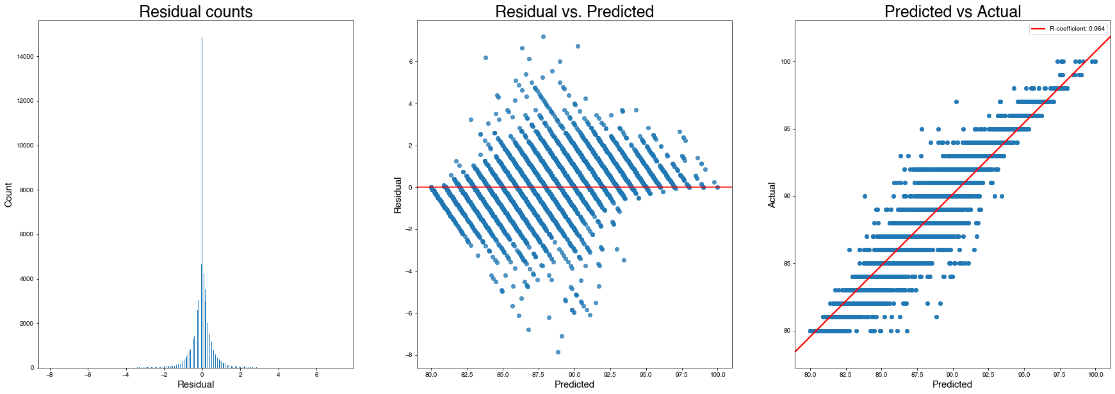
Random Forest Regression: Points
R-squared of the model in training set is: 0.9820391706934485
-----Test set statistics-----
R-squared of the model in test set is: 0.8965005720696049
Root mean squared error of the prediction is: 1.0601651783998995
Random Forest Regression Total runtime: 1538.02 seconds
N_estimators = 20

Slide 45
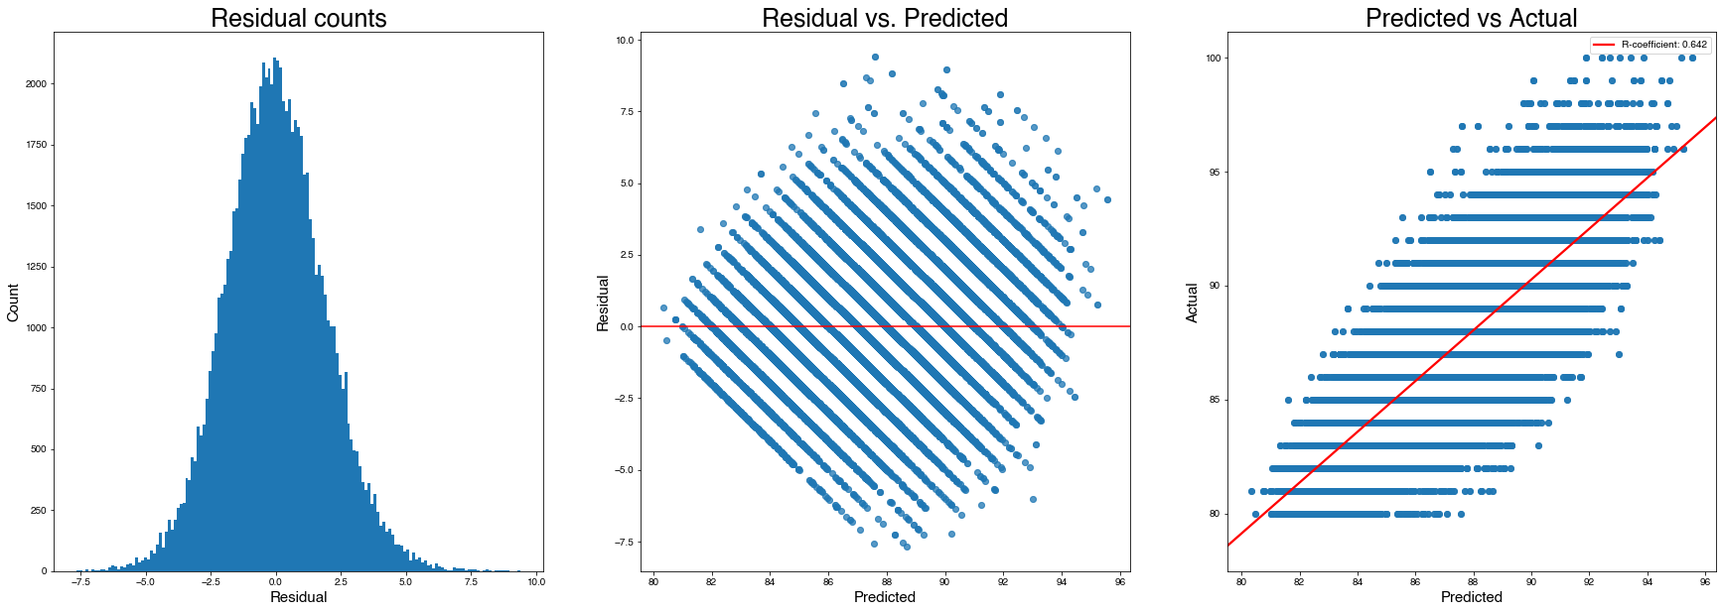
XGBoost Regression: Points
R-squared of the model in training set is: 0.6451487995437091
-----Test set statistics-----
R-squared of the model in test set is: 0.6313938812533615
Root mean squared error of the prediction is: 1.962571936422877
XGBoost Regression Total runtime: 687.81 seconds

Slide 46
Points Regression results
Random Forest Regression once again outperformed all the other models, with good performance.
Highest R-squared (0.896)
Lowest Error RMSE (1.07)
This translates to an RMSE of +/- 1.06 points in rating for wine, with no basis on the cost of the wine
Caveat: Of course, Extremely long runtime (1538.02 seconds)

Slide 47
Conclusions
Results:
For both price and point rating, random forest regressor models proved to be most accurate.
Models for predicting price and points yielded good R-Squared values, indicating a good ratio of explained variation in the dataset. Peak performing random forest models achieved R-Squared values of 0.905 for logprice and .896 for points.
However, R-Squared is not the best measure of accuracy, as it only measures the strength of the relationship between the features and target variable
To interpret the performance of the models, a greater emphasis was placed on the RMSE of the predictions.
RMSE measures the difference between predicted and actual values
Produces a non-negative value, where lower is better (0 indicates perfect fit)
Most importantly, is an absolute measure of fit (as opposed to R-Squared, which is relative)
Model RMSE results are readily interpretable
Results of the regression were pretty good, with a baseline performance of predicting wine prices within USD 1.48 (RMSE = 0.396), and peak performance of predicting prices within USD 1.22 (RMSE = is: 0.201). These predictions were based on the point ratings of the wines, description length, and information derived from the descriptions of the wines written by sommeliers as well as the origins of the wines.
For predicting point ratings of wines, prices were disregarded and only information from the description and origin was used. Results were once again pretty good, with baseline point predictions were within 1.69 points of the actual rating, with peak performance of predictions within 1.06 points.

Slide 48
Conclusions
Caveats and Obstacles:
The "points" ratings in this set are all between 80 and 100 points, so our models are only tailored to predict generally "good" wines.
In addition the ratings are all subjective, as are the individual descriptions by the sommeliers.
Due to the size of the featureset used to predict prices and point ratings, models took very long to run. Even after a 50% dimensionality reduction of the TF-IDF sparse matrix and 82% dimensionality reduction of the wine origin categorical data, the entire featureset was still very large (13603 x 83942, 1.0 GB memory usage).
Random Forests, the best performing models, took extremely long to fit and predict on training and test data. Due to this, comprehensive hyperparameter tuning was not a viable option, as running the model iteratively with different hyperparameters would take far too long. For this reason, Support Vector Machine and K-Nearest Neighbors regression models were not attempted as their runtimes would have been similar.
Random Forests were run with a couple hyperparameters, specifically looking at number of estimators (number of descision trees used in the forest models). Models were initially ran with 10 estimators, and a 100 estimator model was tried on logprice, resulting in a slight increase in performance with respect to RMSE, but 10-fold increase in runtime.

Slide 49
Conclusions
Future Thoughts:
Further refinement of this modeling dataset could be merging it with geographical weather datasets, to predict the best climates for wines to grow.
The same data pipelining method could be applied to user-submitted information for other beverages, such as beer. RateBeer, BeerAdvocate, and Untappd are all beer review websites, with ratings for beers.

